Slide 1
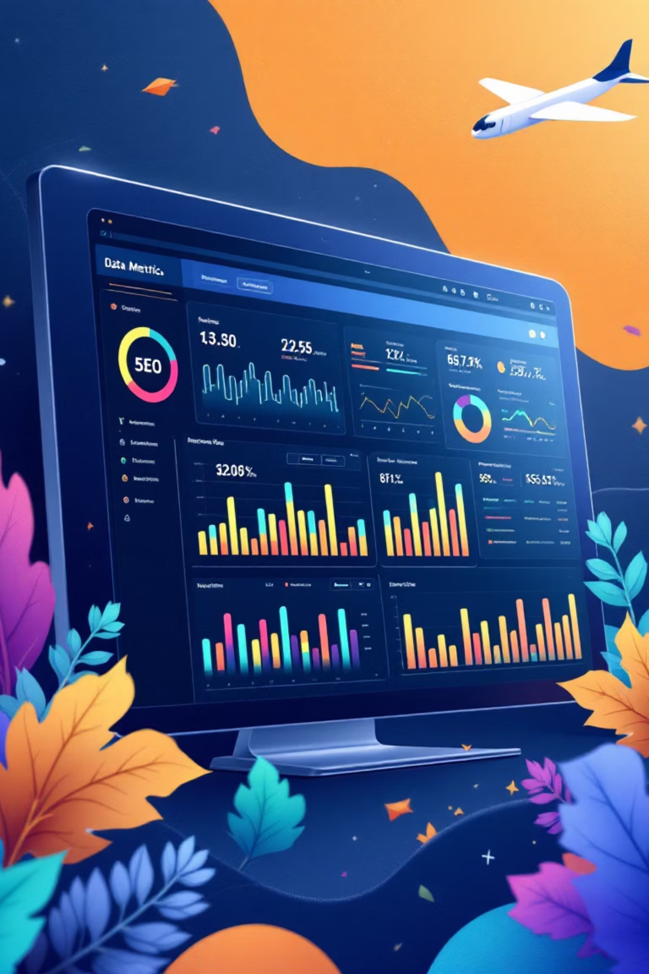
SEO Data Science Assignment
Analyzing SEO data to translate insights into actionable business recommendations for measurable results.

Slide 2

Problem Statement: Drive Measurable Results
Analyze Current SEO Performance
Identify SEO Growth Opportunities
Identify top-performing keywords and strongest potential markets.
Find high search volume keywords with average position > 5 and highlight competitor rankings.
Provide Actionable Business Recommendations
Prioritize improvements (content, technical, backlinks) and suggest new keywords.

Slide 3

Expected Deliverables
1
2
3
Short Report (2-3 pages/slides)
Clear, Prioritized Recommendations
Optional: Impact Estimation
Including methodology, key visualizations, and insights.
Actionable business recommendations for SEO improvement.
Simple model showing organic traffic impact from ranking improvements.

Slide 4
Methodology: Data Preparation & Analysis
01
02
03
Data Ingestion & Initial Review
Data Cleaning & Validation
Type Conversion & Duplicates
Read dataset, import libraries, understand SEO metrics and columns.
Check for spaces, data summary (pd.info, pd.describe), shape, unique values.
Convert numeric columns, confirm no duplicate elements (keywords unique per country).
04
05
NaN Values & Outliers
Insight Collection
Confirmed no NaN values; data was clean with minor CTR outliers.
Proceeded to collect insights from the prepared data.

Slide 5
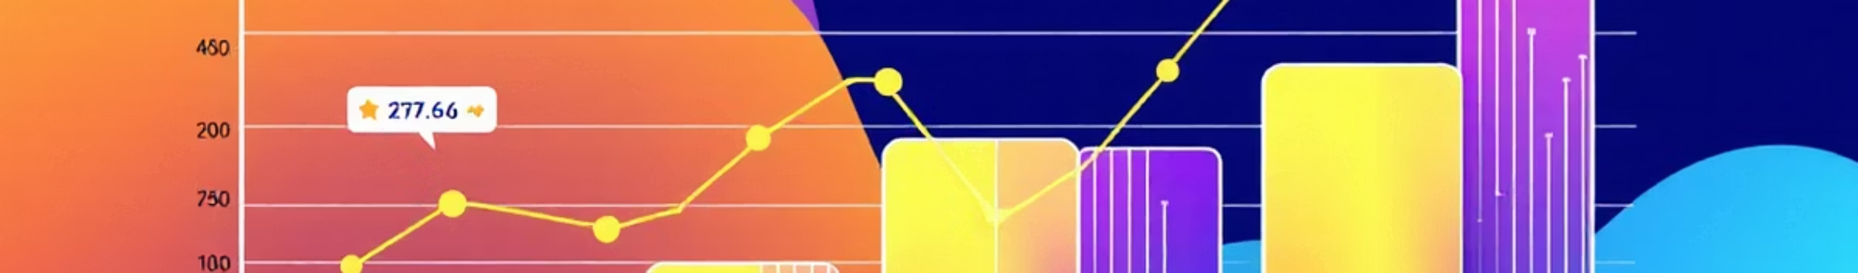
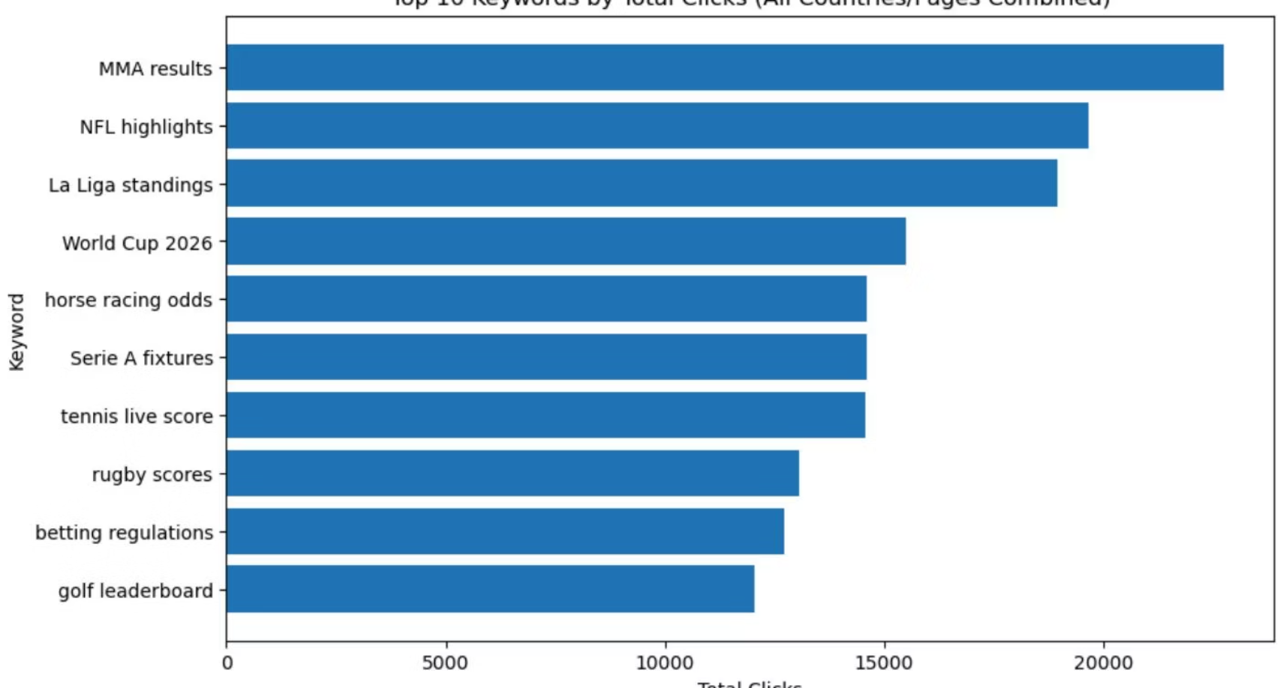
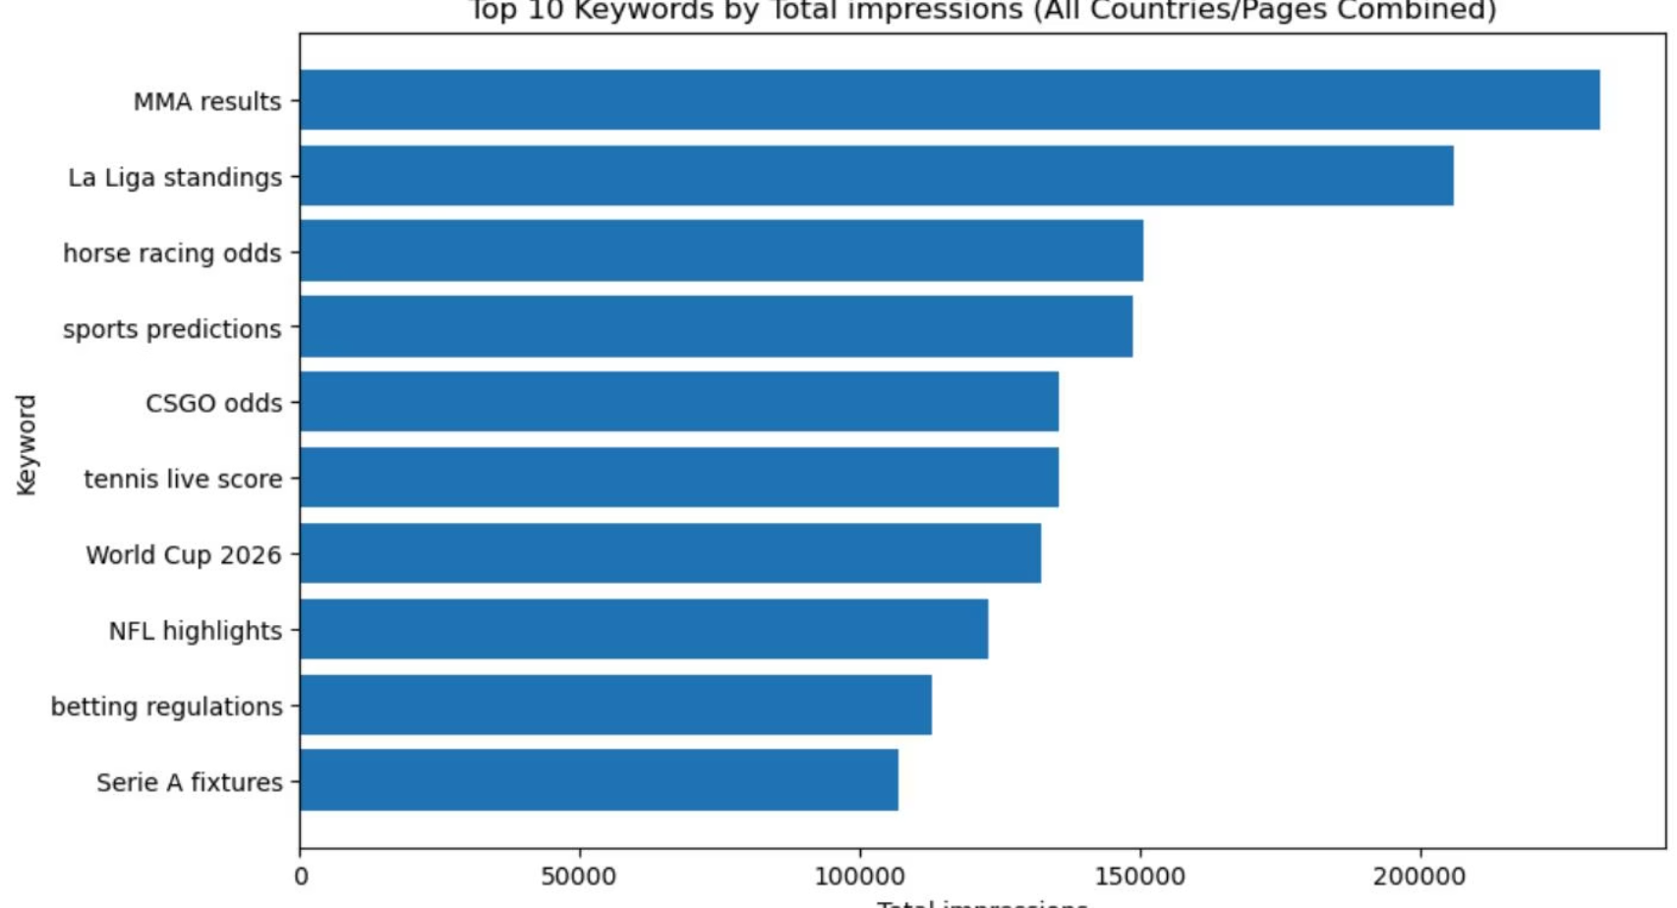
Insights: Best Performing Keywords
Keywords were grouped by country, and metrics like mean, sum on clicks, impressions, and CTR were analyzed.
Top Keywords by Clicks
Top Keywords by Impressions

Slide 6

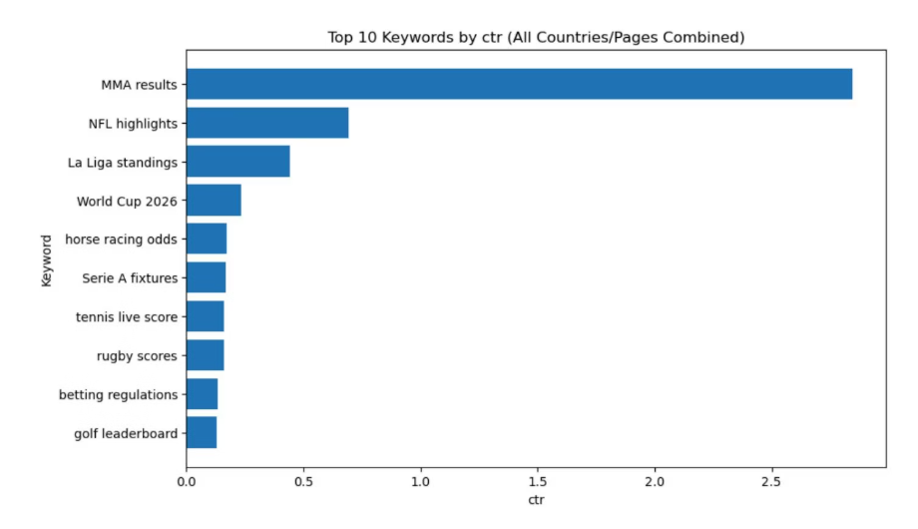
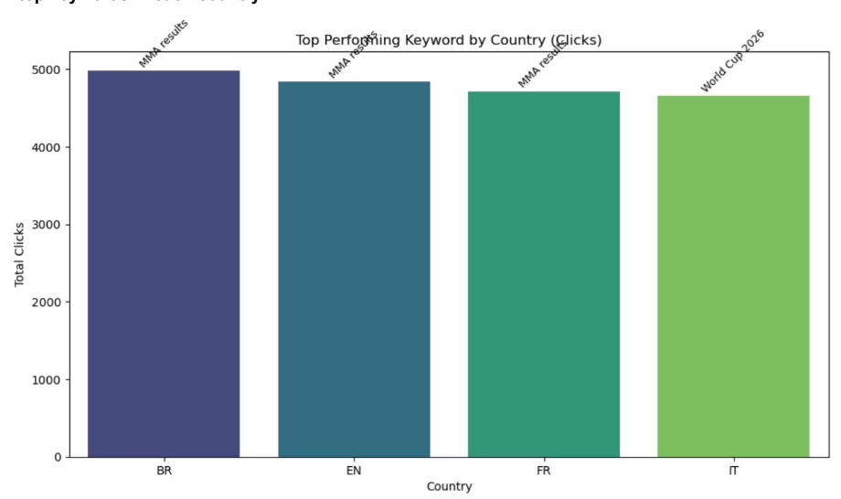
Insights: CTR and Market Potential
Top Keywords by CTR
Top Keywords in Each Country
Italy and England show high potential with average CTRs of 0.18 and 0.16 respectively, despite high impressions. This indicates a significant opportunity to improve content and titles to increase click-through rates.

Slide 7
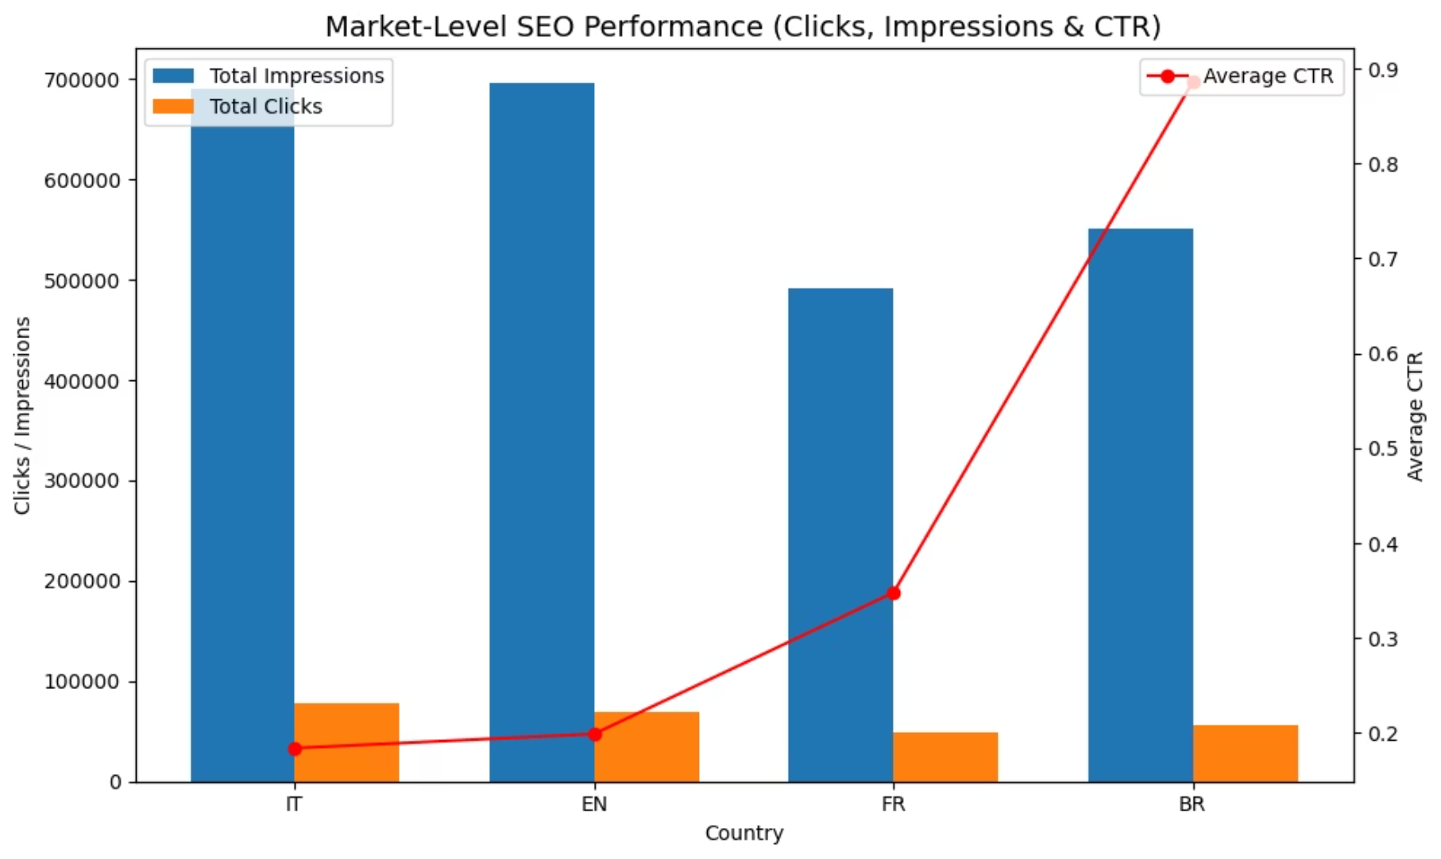
Market-Level Recommendations
Brazil
France
Focus on high-volume, low-competition keywords specific to the Brazilian market.
Conduct a comprehensive content audit to identify gaps and opportunities for improvement.
Localize content fully, ensuring cultural relevance and natural language use.
Address technical SEO aspects unique to French search engines and user behavior.
Explore partnerships with local influencers to build backlinks and authority.
Invest in strategic backlink acquisition from authoritative French websites.
Italy
England
Optimize content and meta descriptions to improve CTR for high-impression keywords (current CTR 0.18).
Refine titles and calls-to-action for existing high-impression content to boost CTR (current CTR 0.16).
Develop targeted content pieces that resonate with Italian user preferences and search intent.
Identify and target long-tail keywords to capture niche search demand.
Monitor competitor rankings closely to identify quick-win opportunities.
Enhance site speed and mobile-friendliness, crucial for the UK market.

Slide 8
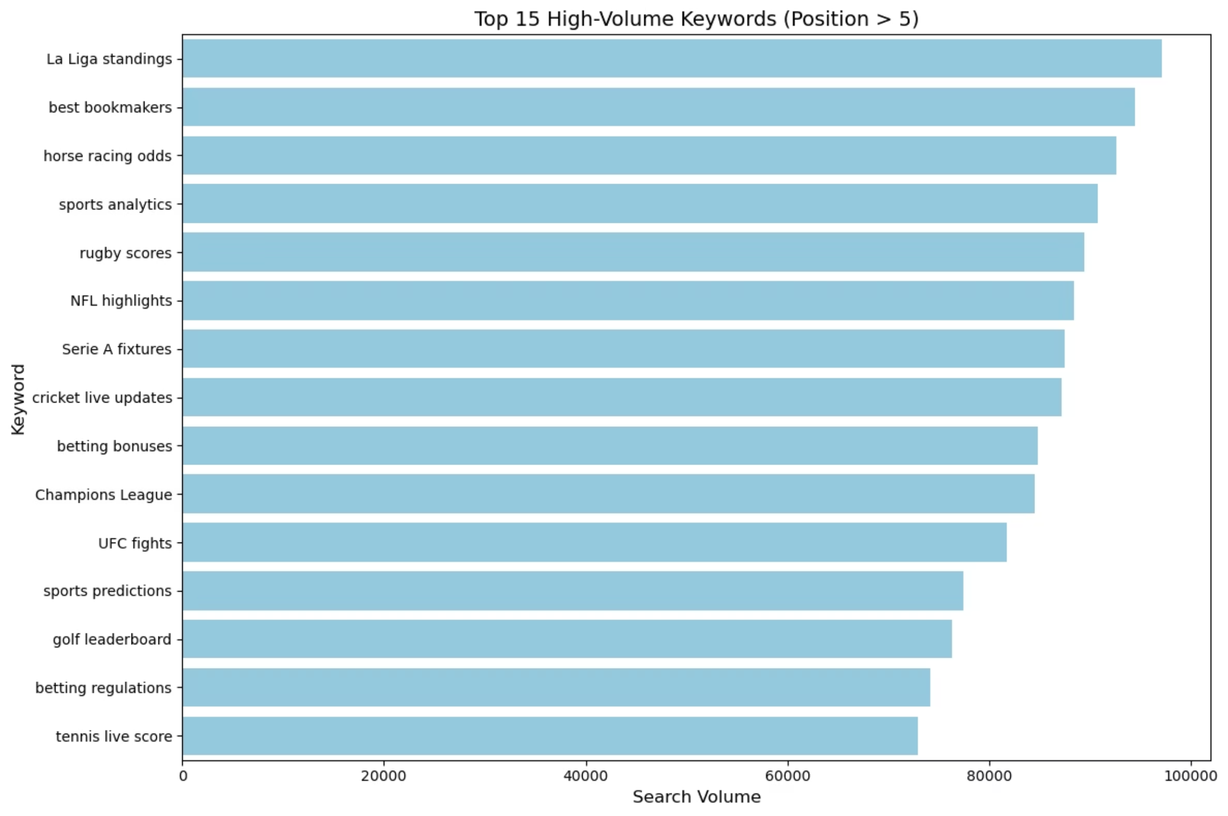
Keyword-Level Recommendations
A) Optimize High-Volume Keywords With Poor Rankings
Prioritize content updates for keywords with high search volume but an average position greater than 5.
Analyze current page content and meta descriptions to improve relevance and click-through rates.
Implement technical SEO improvements to ensure these pages are fully crawlable and indexable.

Slide 9
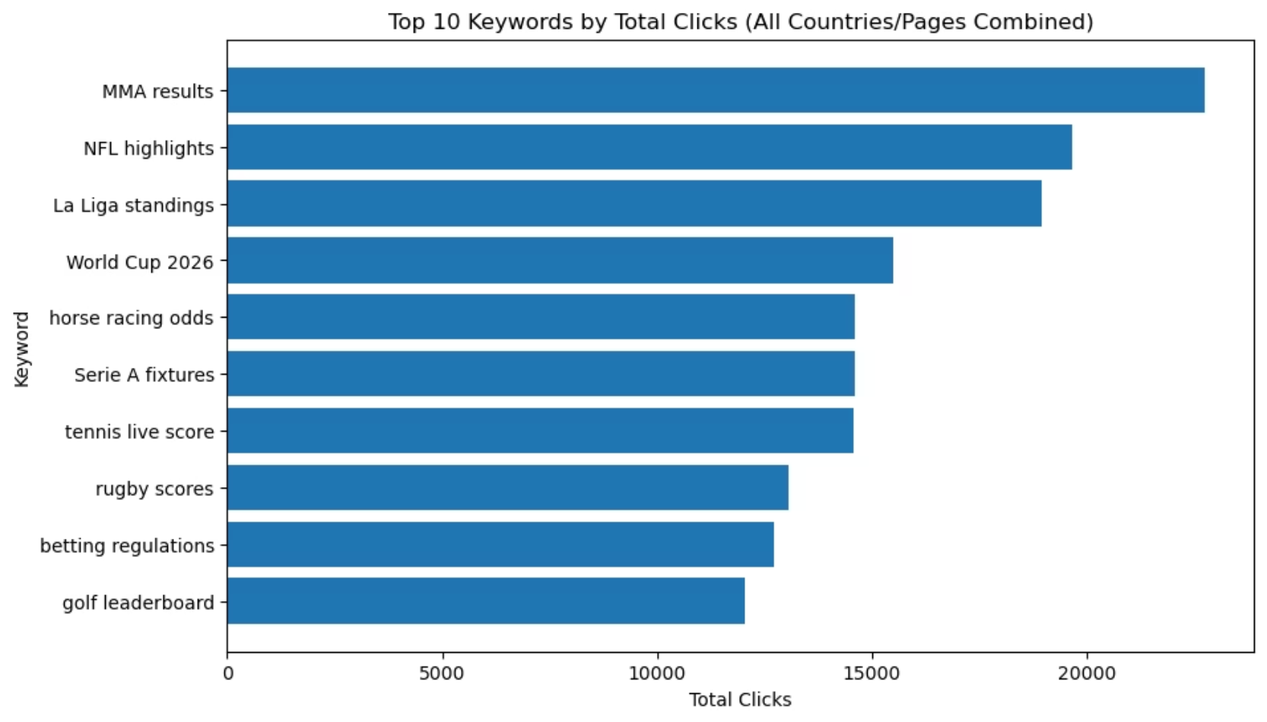
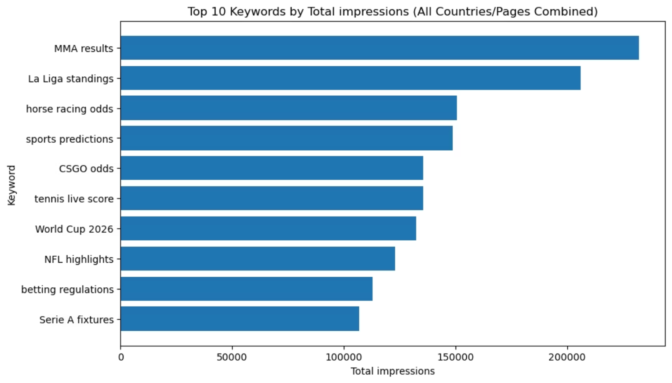
B) Strengthen Content Around Top-Performing Keywords
Expand existing content for keywords that already perform well to capture more long-tail variations and semantic searches.
Enhance user experience on these pages with better internal linking, clearer calls-to-action, and richer media.
Actively seek high-quality backlinks to top-performing pages to further boost their authority and ranking potential.

Slide 10
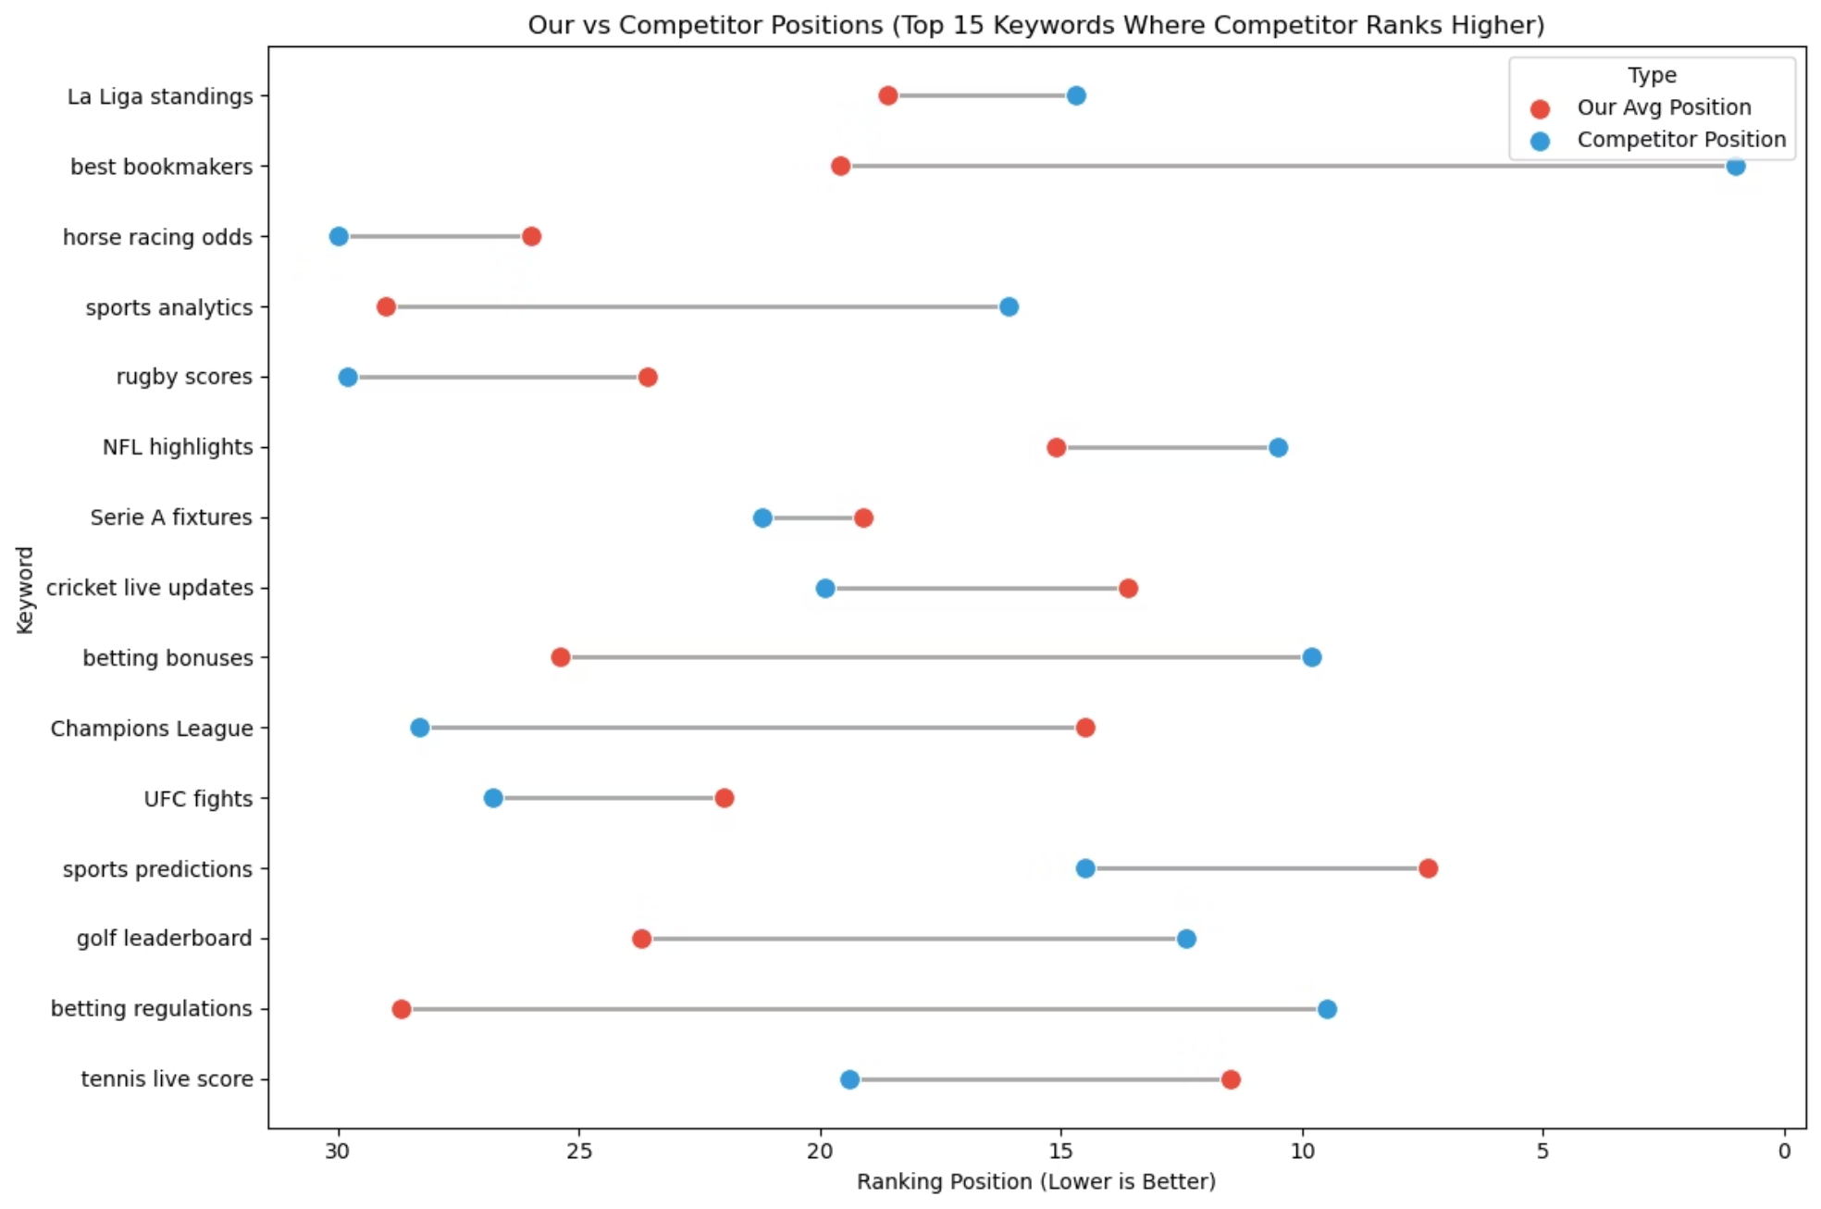
C) Address Keywords Where Competitors Outrank Your Site
Conduct a thorough competitor analysis to understand what makes their content rank higher for target keywords.
Identify gaps in your content strategy and create superior, more comprehensive content that directly addresses user intent.
Develop a targeted backlink acquisition strategy to compete with and surpass competitor domain authority for specific keywords.

Slide 11
Actionable Business Recommendations: Prioritized Improvements
1
Optimize EN & IT content (CTR + title/meta)
High
Medium
Biggest markets, low CTR
2
Update mid-ranking high-volume keywords
High
Low
Quick wins (position > 5)
3
Fix technical issues (speed, schema)
Medium
Medium
Improves site quality
4
Backlink & authority building
High
High
Long-term impact
5
Localization & translations
Medium
Medium
Better local targeting

Slide 12
Actionable Business Recommendations: New Keywords
Suggested new keywords and clusters to target for growth.
0
F1 results
1
UFC fights
2
NBA playoffs
3
tennis live score
4
La Liga standings
5
UFC fights
6
Serie A fixtures
7
tennis live score
8
MMA results
9
La Liga standings
10
sports predictions
11
MMA results

Slide 13
Technical SEO Recommendations
A) Improve Page Speed and Core Web Vitals
Compress images and reduce JavaScript overhead.
Use CDNs and enable server-level caching.
Preload components used in live score pages.
B) Implement SEO Schema
Add FAQ, Article, Breadcrumb, and SportsEvent schema.
Test structured data using Google's Rich Results Tool.
C) Fix Low-CTR Pages
Rewrite titles and descriptions for these specific pages.
Ensure keywords match user intent for those pages.

Slide 14

Content Strategy Recommendations
Our content strategy should focus on building robust content clusters to improve topical authority and search engine visibility. This involves creating central "pillar pages" for broad topics and supporting them with detailed "cluster content" that covers specific related themes.
Key themes identified for content clusters include: live scores, match results, predictions, schedules, and statistics.
Recommendations:
Develop Pillar Pages: Create comprehensive, high-level pillar pages for major sports or leagues (e.g., "Football Hub", "NBA Central") that offer an overview and link out to detailed cluster content.
Create Cluster Content: Produce in-depth articles, data visualizations, and news pieces for each key theme (live scores, match results, predictions, schedules, statistics) for various sports, linking them back to the relevant pillar page.
Implement Robust Internal Linking: Ensure a clear internal linking structure where pillar pages link to all supporting cluster content, and cluster content links back to its main pillar page, as well as to other related cluster content.
This approach will establish topical authority, improve user experience, and enhance search engine rankings for a wide range of relevant queries.
Live Scores
Real-time match updates
Match Results
Post-match summaries
Sports News
Central pillar page for the cluster
Predictions
Pre-match analysis and tips
Statistics
Player and team data

Slide 15
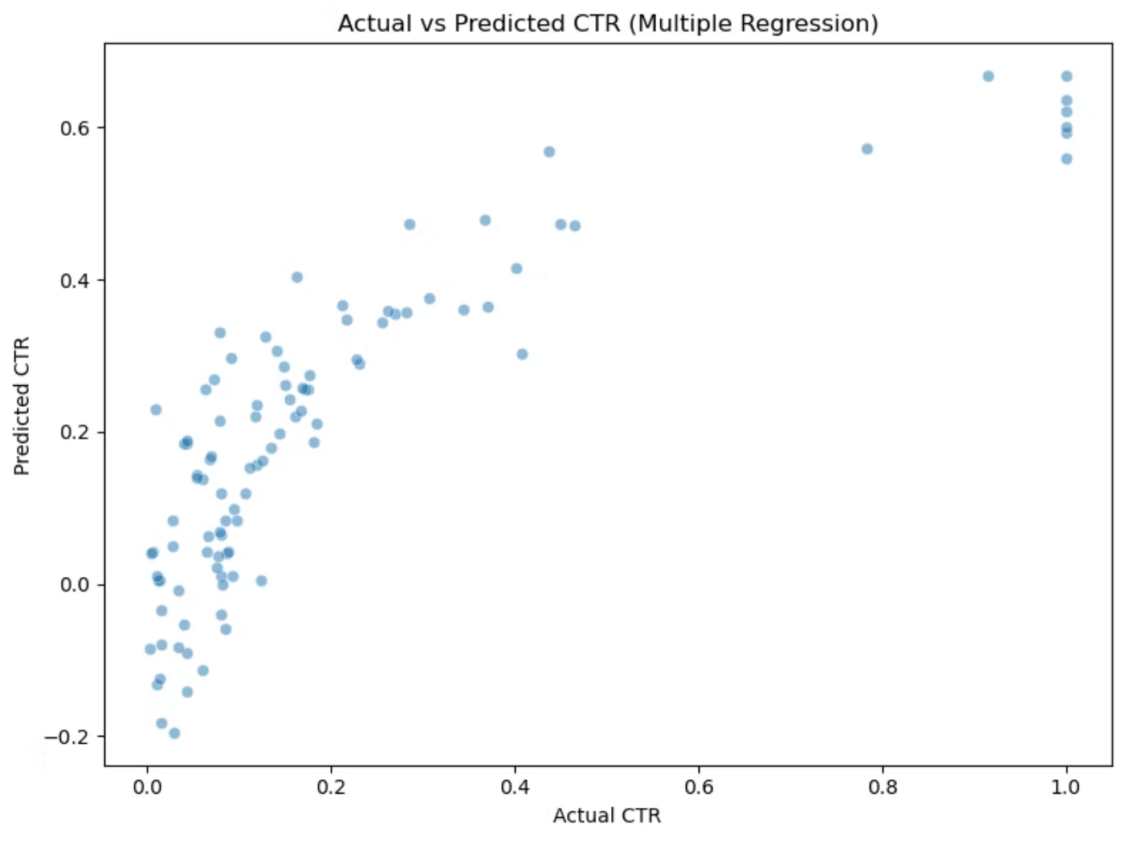
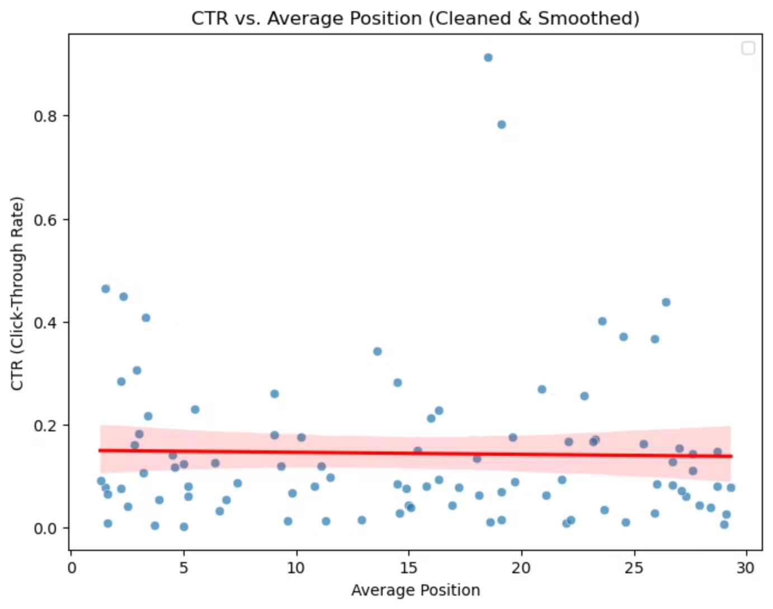
Modeling-Based Recommendations
Our regression model, with an R-squared value of approximately 0.667, provides valuable insights into the factors influencing Click-Through Rate (CTR).
1) Key Findings about CTR Influencers
Ranking Position: Unsurprisingly, higher ranking positions (e.g., #1-3) correlate with significantly higher CTRs. Each incremental improvement in rank yields a disproportionate increase in clicks.
Impressions: While impressions are a prerequisite for clicks, the model indicates that a high volume of impressions without a corresponding improvement in rank does not significantly boost CTR on its own. It's about visibility combined with relevance and position.
Competitor Position: The model suggests that the presence and ranking of strong competitors directly impact our CTR, particularly when they occupy the top positions. Outranking key competitors is crucial for capturing attention.
Search Volume: Keywords with higher search volume, even at lower ranking positions, tend to generate more total clicks, although their individual CTRs might be lower than high-ranking, lower-volume keywords.
2) Actionable Recommendations based on the Model
Target Top Ranks: Focus optimization efforts on pushing critical keywords into the top 3 positions, as this is where the most significant CTR gains are observed.
Optimize Snippets: For high-impression keywords, even if not top-ranked, refine meta descriptions and titles to be more compelling and encourage clicks over competitors.
Competitive Analysis: Regularly monitor competitor rankings for shared keywords and adapt content and SEO strategies to directly compete for higher positions.
Leverage High Volume: For high-search-volume keywords where top ranks are harder to achieve, consider content expansion to capture more long-tail variations and improve overall visibility and click potential.
3) Next Steps for Model Improvement
More Data: Continuously feed the model with fresh data to refine its predictions and identify emerging trends in CTR influencing factors.
Sophisticated Model: Explore advanced machine learning models beyond multiple linear regression, such as gradient boosting or neural networks, to capture more complex non-linear relationships.
Additional Variables: Incorporate new features into the model, such as page load speed, mobile-friendliness scores, and user engagement metrics, to enhance predictive accuracy.

Slide 16
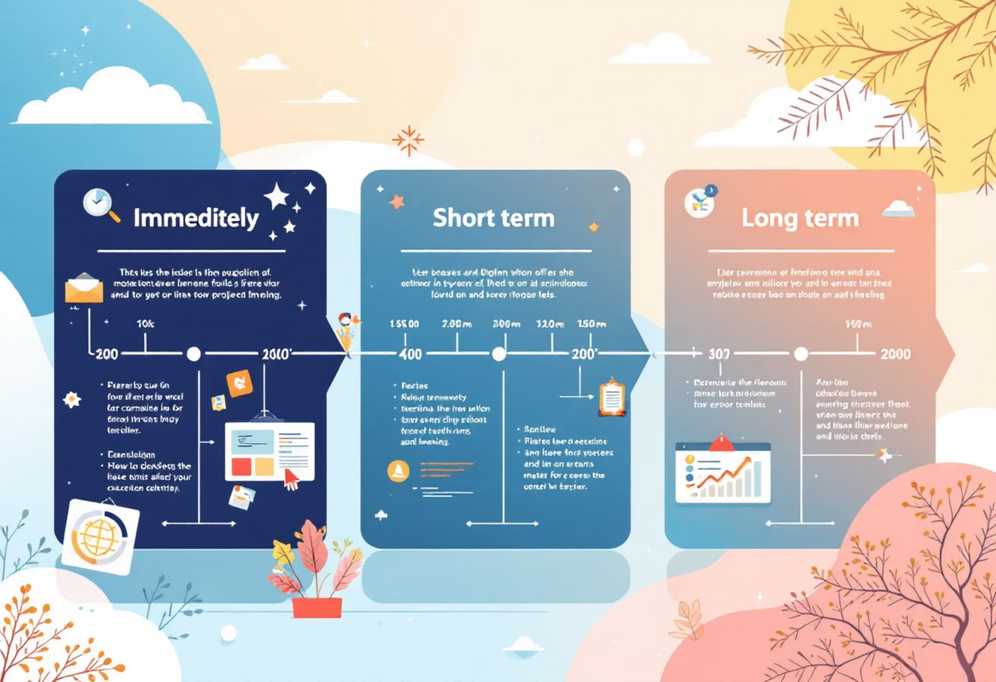
Overall Prioritized Action Plan
Here's a breakdown of our strategic actions, categorized by their intended timeframe, designed to optimize our SEO performance and achieve sustainable growth.
Immediate (1-2 weeks)
Prioritize critical on-page SEO fixes based on audit.
Implement FAQ, Article, Breadcrumb, and SportsEvent schema.
Compress images and reduce JavaScript overhead on key pages.
Short Term (1-2 months)
Rewrite titles and descriptions for identified low-CTR pages.
Develop initial pillar pages for major sports/leagues (e.g., "Football Hub").
Create supporting cluster content for live scores, match results, and predictions.
Execute targeted backlink acquisition campaigns for high-priority keywords.
Long Term (3-6 months)
Refine snippet optimization for high-impression keywords.
Expand content to cover long-tail keyword variations across all clusters.
Continuously feed the regression model with fresh data to refine predictions.
Explore advanced machine learning models for CTR prediction.
Integrate new variables (page load speed, mobile-friendliness) into the model.
Expand content for schedules and statistics themes.
This phased approach ensures we balance quick wins with foundational long-term strategies, driving sustained SEO performance and market leadership.

